Slide 1
Web Applications and Services
James Walden
Northern Kentucky University

Slide 2
Topics
OWASP Top 10 2010 Presentation
HTTP Vulnerabilities
Web Servers
Web Services

Slide 3
OWASP Top 10 – 2010 The Top 10 Most Critical Web Application Security Risks Dave Wichers COO, Aspect Security OWASP Board Member dave.wichers@aspectsecurity.com dave.wichers@owasp.org

Slide 4

OWASP Top Ten (2010 Edition)
A1: Injection
A10: Unvalidated Redirects and Forwards
A7: Failure to Restrict URL Access
A6: Security Misconfiguration
A5: Cross Site Request Forgery (CSRF)
A4: Insecure Direct Object References
A3: Broken Authentication and Session Management
A2: Cross-Site Scripting (XSS)
A8: Insecure Cryptographic Storage
A9: Insufficient Transport Layer Protection
http://www.owasp.org/index.php/Top_10
Notes:
The red ones are the new ones.

Slide 5
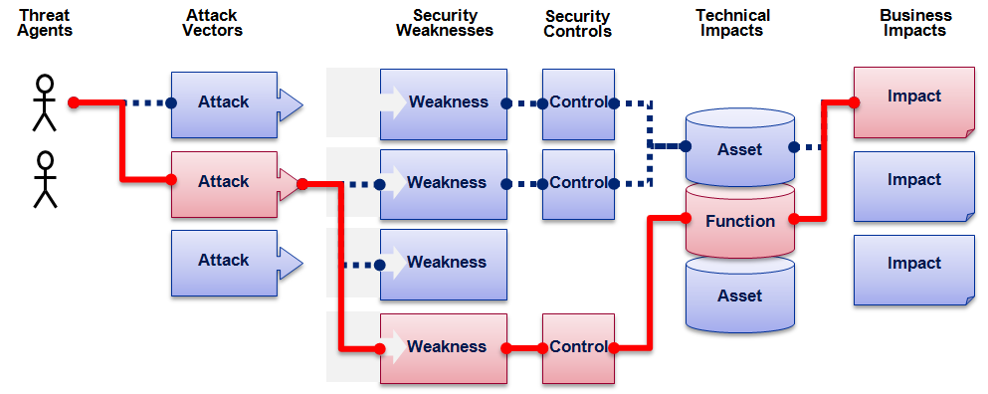

OWASP Top 10 Risk Rating Methodology
Threat Agent | Attack Vector | Weakness Prevalence | Weakness Detectability | Technical Impact | Business Impact
? | Easy | Widespread | Easy | Severe | ?
 | Average | Common | Average | Moderate
 | Difficult | Uncommon | Difficult | Minor
 | 1 | 2 | 2 | 1
 |  | 1.66 | * | 1
1
2
3
Injection Example
1.66 weighted risk rating

Slide 6
A1 – Injection
Injection means…
Tricking an application into including unintended commands in the data sent to an interpreter
Interpreters…
Take strings and interpret them as commands
SQL, OS Shell, LDAP, XPath, Hibernate, etc…
SQL injection is still quite common
Many applications still susceptible (really don’t know why)
Even though it’s usually very simple to avoid
Typical Impact
Usually severe. Entire database can usually be read or modified
May also allow full database schema, or account access, or even OS level access

Slide 7
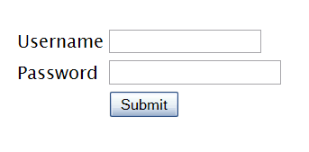
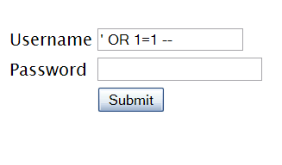

SQL Injection – Illustrated
"SELECT * FROM accounts WHERE acct=‘’ OR 1=1--’"
Account Summary
Acct:5424-6066-2134-4334
Acct:4128-7574-3921-0192
Acct:5424-9383-2039-4029
Acct:4128-0004-1234-0293
Account:
Account:
SKU:
DB Table 

SKU:
HTTP response 

HTTP request
Finance
SQL query
Transactions
Accounts
Administration
Communication
Knowledge Mgmt
E-Commerce
Bus. Functions
Databases
Legacy Systems
Web Services
Directories
Billing
Application Layer
Human Resrcs
APPLICATION ATTACK
Custom Code
1. Application presents a form to the attacker
2. Attacker sends an attack in the form data
App Server
3. Application forwards attack to the database in a SQL query
Web Server
Hardened OS
4. Database runs query containing attack and sends encrypted results back to application
Network Layer
Firewall
Firewall
5. Application decrypts data as normal and sends results to the user

Slide 8
A1 – Avoiding Injection Flaws
Recommendations
Avoid the interpreter entirely, or
Use an interface that supports bind variables (e.g., prepared statements, or stored procedures),
Bind variables allow the interpreter to distinguish between code and data
Encode all user input before passing it to the interpreter
Always perform ‘white list’ input validation on all user supplied input
Always minimize database privileges to reduce the impact of a flaw
References
For more details, read the new http://www.owasp.org/index.php/SQL_Injection_Prevention_Cheat_Sheet

Slide 9
A2 – Cross-Site Scripting (XSS)
Occurs any time…
Raw data from attacker is sent to an innocent user’s browser
Raw data…
Stored in database
Reflected from web input (form field, hidden field, URL, etc…)
Sent directly into rich JavaScript client
Virtually every web application has this problem
Try this in your browser – javascript:alert(document.cookie)
Typical Impact
Steal user’s session, steal sensitive data, rewrite web page, redirect user to phishing or malware site
Most Severe: Install XSS proxy which allows attacker to observe and direct all user’s behavior on vulnerable site and force user to other sites

Slide 10
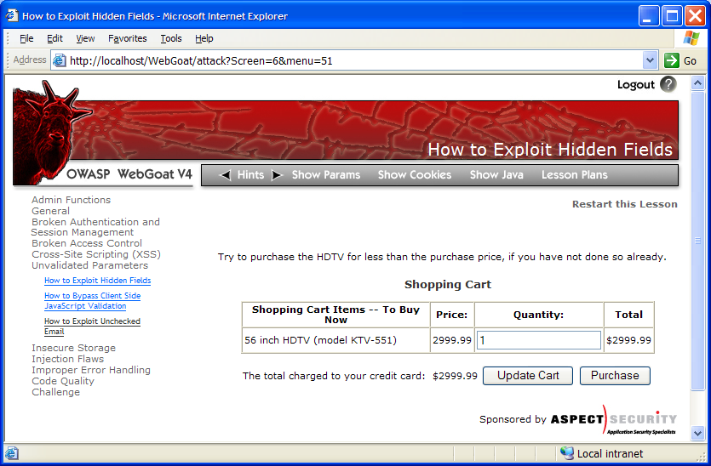

Cross-Site Scripting Illustrated
1
Attacker sets the trap – update my profile
Application with stored XSS vulnerability
Attacker enters a malicious script into a web page that stores the data on the server
2
Victim views page – sees attacker profile
Finance
Transactions
Accounts
Administration
Communication
Knowledge Mgmt
E-Commerce
Bus. Functions
Custom Code
Script runs inside victim’s browser with full access to the DOM and cookies
3
Script silently sends attacker Victim’s session cookie

Slide 11
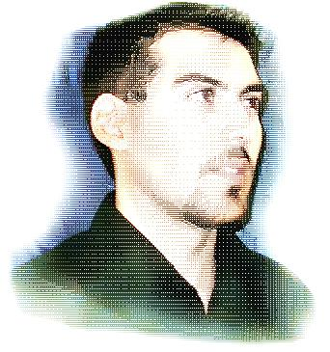
A2 – Avoiding XSS Flaws
Recommendations
Eliminate Flaw
Don’t include user supplied input in the output page
Defend Against the Flaw
Primary Recommendation: Output encode all user supplied input (Use OWASP’s ESAPI to output encode:
http://www.owasp.org/index.php/ESAPI
Perform ‘white list’ input validation on all user input to be included in page
For large chunks of user supplied HTML, use OWASP’s AntiSamy to sanitize this HTML to make it safe
See: http://www.owasp.org/index.php/AntiSamy
References
For how to output encode properly, read the new http://www.owasp.org/index.php/XSS_(Cross Site Scripting) Prevention Cheat Sheet
(AntiSamy)

Slide 12
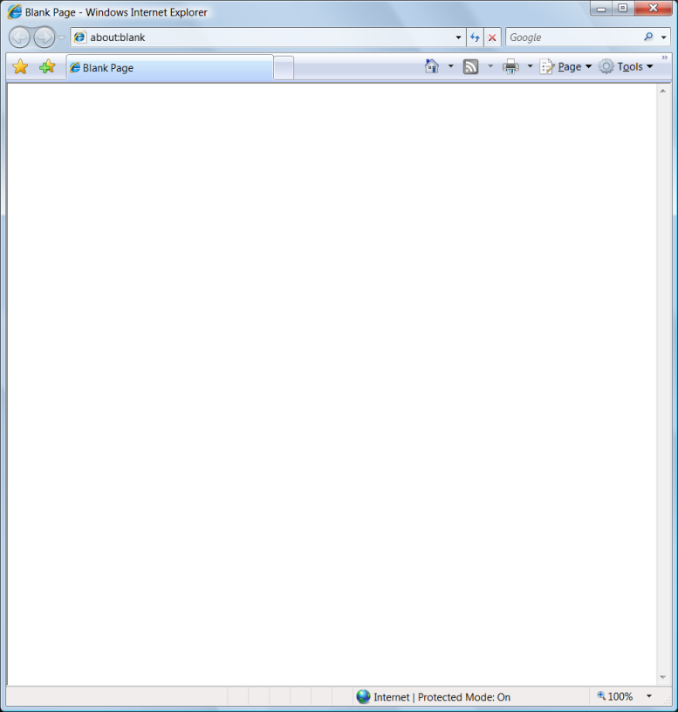
Safe Escaping Schemes in Various HTML Execution Contexts
#1: ( &, <, >, " ) → &entity; ( ', / ) → &#xHH;
ESAPI: encodeForHTML()
HTML Element Content
(e.g., <div> some text to display </div> )
#2: All non-alphanumeric < 256 → &#xHH
ESAPI: encodeForHTMLAttribute()
HTML Attribute Values
(e.g., <input name='person' type='TEXT' value='defaultValue'> )
#3: All non-alphanumeric < 256 → \xHH
ESAPI: encodeForJavaScript()
JavaScript Data
(e.g., <script> some javascript </script> )
#4: All non-alphanumeric < 256 → \HH
ESAPI: encodeForCSS()
HTML Style Property Values
(e.g., .pdiv a:hover {color: red; text-decoration: underline} )
#5: All non-alphanumeric < 256 → %HH
ESAPI: encodeForURL()
URI Attribute Values
(e.g., <a href="javascript:toggle('lesson')" )
ALL other contexts CANNOT include Untrusted Data
Recommendation: Only allow #1 and #2 and disallow all others
See: www.owasp.org/index.php/XSS_(Cross_Site_Scripting)_Prevention_Cheat_Sheet for more details

Slide 13
A3 – Broken Authentication and Session Management
HTTP is a “stateless” protocol
Means credentials have to go with every request
Should use SSL for everything requiring authentication
Session management flaws
SESSION ID used to track state since HTTP doesn’t
and it is just as good as credentials to an attacker
SESSION ID is typically exposed on the network, in browser, in logs, …
Beware the side-doors
Change my password, remember my password, forgot my password, secret question, logout, email address, etc…
Typical Impact
User accounts compromised or user sessions hijacked

Slide 14
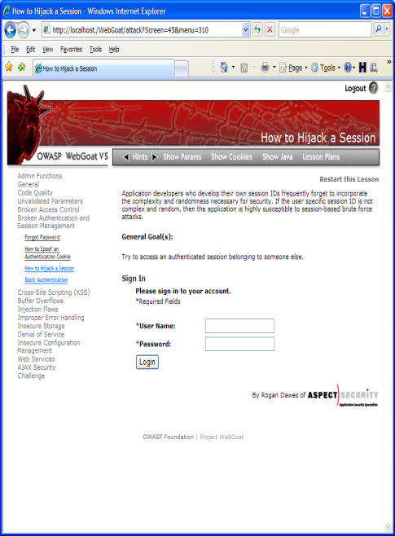
Broken Authentication Illustrated
1
User sends credentials
Finance
Transactions
Accounts
Administration
Communication
Knowledge Mgmt
E-Commerce
www.boi.com?JSESSIONID=9FA1DB9EA...
Bus. Functions
Site uses URL rewriting
(i.e., put session in URL)
2
Custom Code
3
User clicks on a link to http://www.hacker.com in a forum
Hacker checks referer logs on www.hacker.com
and finds user’s JSESSIONID
4
5
Hacker uses JSESSIONID and takes over victim’s account

Slide 15
A3 – Avoiding Broken Authentication and Session Management
Verify your architecture
Authentication should be simple, centralized, and standardized
Use the standard session id provided by your container
Be sure SSL protects both credentials and session id at all times
Verify the implementation
Forget automated analysis approaches
Check your SSL certificate
Examine all the authentication-related functions
Verify that logoff actually destroys the session
Use OWASP’s WebScarab to test the implementation
Follow the guidance from
http://www.owasp.org/index.php/Authentication_Cheat_Sheet

Slide 16
A4 – Insecure Direct Object References
How do you protect access to your data?
This is part of enforcing proper “Authorization”, along with A7 – Failure to Restrict URL Access
A common mistake …
Only listing the ‘authorized’ objects for the current user, or
Hiding the object references in hidden fields
This is called presentation layer access control, and doesn’t work
Attacker simply tampers with parameter value
Typical Impact
Users are able to access unauthorized files or data
… and then not enforcing these restrictions on the server side

Slide 17
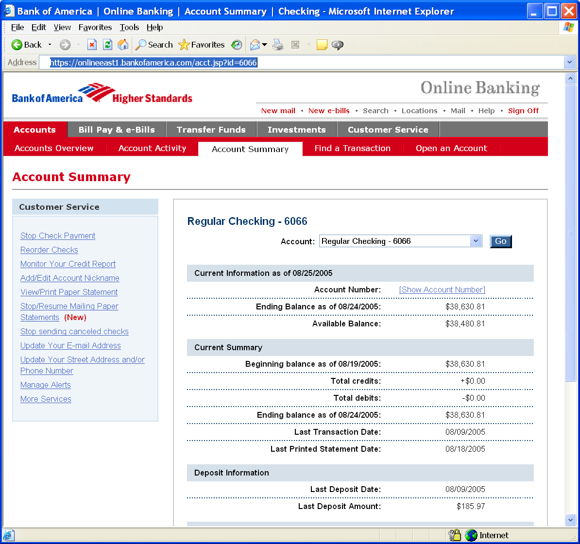
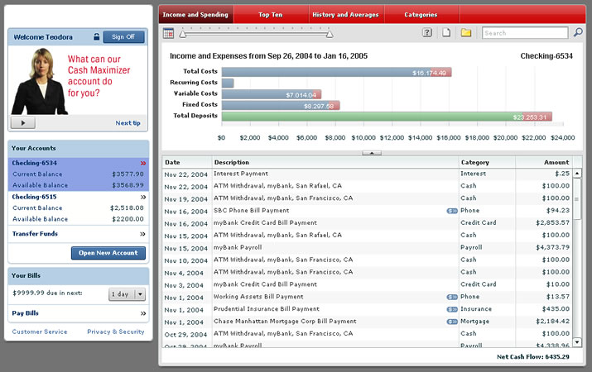
Insecure Direct Object References Illustrated
Attacker notices his acct parameter is 6065
?acct=6065
He modifies it to a nearby number
?acct=6066
Attacker views the victim’s account information
https://www.onlinebank.com/user?acct=6065

Slide 18
A4 – Avoiding Insecure Direct Object References
Eliminate the direct object reference
Replace them with a temporary mapping value (e.g. 1, 2, 3)
ESAPI provides support for numeric & random mappings
IntegerAccessReferenceMap & RandomAccessReferenceMap
Validate the direct object reference
Verify the parameter value is properly formatted
Verify the user is allowed to access the target object
Query constraints work great!
Verify the requested mode of access is allowed to the target object (e.g., read, write, delete)
http://app?file=Report123.xls
Access
Reference
Map
Report123.xls
http://app?file=1
http://app?id=9182374
Acct:9182374
http://app?id=7d3J93

Slide 19
A5 – Cross Site Request Forgery (CSRF)
Cross Site Request Forgery
An attack where the victim’s browser is tricked into issuing a command to a vulnerable web application
Vulnerability is caused by browsers automatically including user authentication data (session ID, IP address, Windows domain credentials, …) with each request
Imagine…
What if a hacker could steer your mouse and get you to click on links in your online banking application?
What could they make you do?
Typical Impact
Initiate transactions (transfer funds, logout user, close account)
Access sensitive data
Change account details

Slide 20

CSRF Vulnerability Pattern
The Problem
Web browsers automatically include most credentials with each request
Even for requests caused by a form, script, or image on another site
All sites relying solely on automatic credentials are vulnerable!
(almost all sites are this way)
Automatically Provided Credentials
Session cookie
Basic authentication header
IP address
Client side SSL certificates
Windows domain authentication

Slide 21
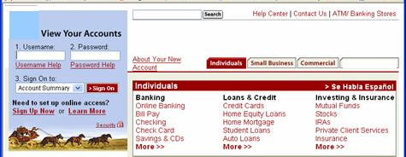
CSRF Illustrated
Attacker sets the trap on some website on the internet (or simply via an e-mail)
1
Application with CSRF vulnerability
Hidden <img> tag contains attack against vulnerable site
Finance
Transactions
Accounts
Administration
Communication
Knowledge Mgmt
E-Commerce
Bus. Functions
2
While logged into vulnerable site, victim views attacker site
Custom Code
3
Vulnerable site sees legitimate request from victim and performs the action requested
<img> tag loaded by browser – sends GET request (including credentials) to vulnerable site

Slide 22
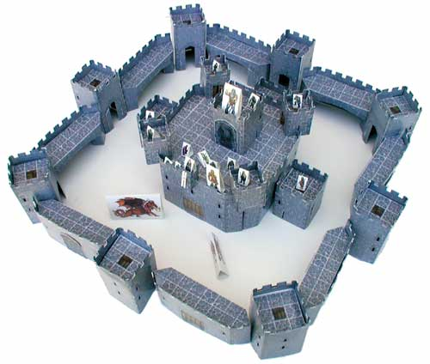
A5 – Avoiding CSRF Flaws
Add a secret, not automatically submitted, token to ALL sensitive requests
This makes it impossible for the attacker to spoof the request
(unless there’s an XSS hole in your application)
Tokens should be cryptographically strong or random
Options
Store a single token in the session and add it to all forms and links
Hidden Field: <input name="token" value="687965fdfaew87agrde" type="hidden"/>
Single use URL: /accounts/687965fdfaew87agrde
Form Token: /accounts?auth=687965fdfaew87agrde …
Beware exposing the token in a referer header
Hidden fields are recommended
Can have a unique token for each function
Use a hash of function name, session id, and a secret
Can require secondary authentication for sensitive functions (e.g., eTrade)
Don’t allow attackers to store attacks on your site
Properly encode all input on the way out
This renders all links/requests inert in most interpreters
See the new: www.owasp.org/index.php/CSRF_Prevention_Cheat_Sheet
for more details

Slide 23
A6 – Security Misconfiguration
Web applications rely on a secure foundation
Everywhere from the OS up through the App Server
Don’t forget all the libraries you are using!!
Is your source code a secret?
Think of all the places your source code goes
Security should not require secret source code
CM must extend to all parts of the application
All credentials should change in production
Typical Impact
Install backdoor through missing OS or server patch
XSS flaw exploits due to missing application framework patches
Unauthorized access to default accounts, application functionality or data, or unused but accessible functionality due to poor server configuration

Slide 24
Security Misconfiguration Illustrated
Finance
Database
Transactions
Accounts
Administration
Communication
Knowledge Mgmt
E-Commerce
Bus. Functions
Custom Code
App Configuration
Framework
Development
App Server
Web Server
QA Servers
Insider
Hardened OS
Test Servers
Source Control

Slide 25
A6 – Avoiding Security Misconfiguration
Verify your system’s configuration management
Secure configuration “hardening” guideline
Automation is REALLY USEFUL here
Must cover entire platform and application
Keep up with patches for ALL components
This includes software libraries, not just OS and Server applications
Analyze security effects of changes
Can you “dump” the application configuration
Build reporting into your process
If you can’t verify it, it isn’t secure
Verify the implementation
Scanning finds generic configuration and missing patch problems

Slide 26
A7 – Insecure Cryptographic Storage
Storing sensitive data insecurely
Failure to identify all sensitive data
Failure to identify all the places that this sensitive data gets stored
Databases, files, directories, log files, backups, etc.
Failure to properly protect this data in every location
Typical Impact
Attackers access or modify confidential or private information
Attackers extract secrets to use in additional attacks
Company embarrassment, customer dissatisfaction, and loss of trust
Expense of cleaning up the incident, such as forensics, sending apology letters, reissuing thousands of credit cards, providing identity theft insurance
Business gets sued and/or fined
e.g, credit cards, health care records, financial data (yours or your customers)

Slide 27
Insecure Cryptographic Storage Illustrated
Victim enters credit card number in form
1
Finance
Transactions
Accounts
Administration
Communication
Knowledge Mgmt
E-Commerce
Bus. Functions
Custom Code
Log files
4
Malicious insider steals 4 million credit card numbers
Error handler logs CC details because merchant gateway is unavailable
2
Logs are accessible to all members of IT staff for debugging purposes
3

Slide 28
A7 – Avoiding Insecure Cryptographic Storage
Verify your architecture
Identify all sensitive data
Identify all the places that data is stored
Ensure threat model accounts for possible attacks
Use encryption to counter the threats, don’t just ‘encrypt’ the data
Protect with appropriate mechanisms
File encryption, database encryption, data element encryption
Use the mechanisms correctly
Use standard strong algorithms
Generate, distribute, and protect keys properly
Be prepared for key change
Verify the implementation
A standard strong algorithm is used, and it’s the proper algorithm for this situation
All keys, certificates, and passwords are properly stored and protected
Safe key distribution and an effective plan for key change are in place
Analyze encryption code for common flaws

Slide 29
A8 – Failure to Restrict URL Access
How do you protect access to URLs (pages)?
This is part of enforcing proper “authorization”, along with A4 – Insecure Direct Object References
A common mistake …
Displaying only authorized links and menu choices
This is called presentation layer access control, and doesn’t work
Attacker simply forges direct access to ‘unauthorized’ pages
Typical Impact
Attackers invoke functions and services they’re not authorized for
Access other user’s accounts and data
Perform privileged actions

Slide 30
Failure to Restrict URL Access Illustrated
Attacker notices the URL indicates his role
/user/getAccounts
He modifies it to another directory (role)
/admin/getAccounts, or
/manager/getAccounts
Attacker views more accounts than just their own

Slide 31
A8 – Avoiding URL Access Control Flaws
For each URL, a site needs to do 3 things
Restrict access to authenticated users (if not public)
Enforce any user or role based permissions (if private)
Completely disallow requests to unauthorized page types (e.g., config files, log files, source files, etc.)
Verify your architecture
Use a simple, positive model at every layer
Be sure you actually have a mechanism at every layer
Verify the implementation
Forget automated analysis approaches
Verify that each URL in your application is protected by either
An external filter, like Java EE web.xml or a commercial product
Or internal checks in YOUR code – Use ESAPI’s isAuthorizedForURL() method
Verify the server configuration disallows requests to unauthorized file types
Use WebScarab or your browser to forge unauthorized requests

Slide 32
A9 – Insufficient Transport Layer Protection
Transmitting sensitive data insecurely
Failure to identify all sensitive data
Failure to identify all the places that this sensitive data is sent
On the web, to backend databases, to business partners, internal communications
Failure to properly protect this data in every location
Typical Impact
Attackers access or modify confidential or private information
e.g, credit cards, health care records, financial data (yours or your customers)
Attackers extract secrets to use in additional attacks
Company embarrassment, customer dissatisfaction, and loss of trust
Expense of cleaning up the incident
Business gets sued and/or fined

Slide 33


Insufficient Transport Layer Protection Illustrated
Business Partners
External Victim
Custom Code
Backend Systems
Employees
1
2
External attacker steals credentials and data off network
Internal attacker steals credentials and data from internal network
External Attacker
Internal Attacker

Slide 34
A9 – Avoiding Insufficient Transport Layer Protection
Protect with appropriate mechanisms
Use TLS on all connections with sensitive data
Individually encrypt messages before transmission
E.g., XML-Encryption
Sign messages before transmission
E.g., XML-Signature
Use the mechanisms correctly
Use standard strong algorithms (disable old SSL algorithms)
Manage keys/certificates properly
Verify SSL certificates before using them
Use proven mechanisms when sufficient
E.g., SSL vs. XML-Encryption
See: http://www.owasp.org/index.php/Transport_Layer_Protection_Cheat _Sheet for more details

Slide 35
A10 – Unvalidated Redirects and Forwards
Web application redirects are very common
And frequently include user supplied parameters in the destination URL
If they aren’t validated, attacker can send victim to a site of their choice
Forwards (aka Transfer in .NET) are common too
They internally send the request to a new page in the same application
Sometimes parameters define the target page
If not validated, attacker may be able to use unvalidated forward to bypass authentication or authorization checks
Typical Impact
Redirect victim to phishing or malware site
Attacker’s request is forwarded past security checks, allowing unauthorized function or data access

Slide 36

Unvalidated Redirect Illustrated
1
Attacker sends attack to victim via email or webpage
From: Internal Revenue Service Subject: Your Unclaimed Tax Refund Our records show you have an unclaimed federal tax refund. Please click here to initiate your claim.
3
Application redirects victim to attacker’s site
2
Victim clicks link containing unvalidated parameter
Finance
Transactions
Accounts
Administration
Communication
Knowledge Mgmt
E-Commerce
Bus. Functions
Custom Code
Request sent to vulnerable site, including attacker’s destination site as parameter. Redirect sends victim to attacker site
Evil Site
4
Evil site installs malware on victim, or phish’s for private information
http://www.irs.gov/taxrefund/claim.jsp?year=2006& … &dest=www.evilsite.com

Slide 37
Unvalidated Forward Illustrated
1
Attacker sends attack to vulnerable page they have access to
Request sent to vulnerable page which user does have access to. Redirect sends user directly to private page, bypassing access control.
public void sensitiveMethod( HttpServletRequest request, HttpServletResponse response) {
try {
// Do sensitive stuff here.
...
}
catch ( ...
2
Application authorizes request, which continues to vulnerable page
Filter
3
Forwarding page fails to validate parameter, sending attacker to unauthorized page, bypassing access control
public void doPost( HttpServletRequest request, HttpServletResponse response) {
try {
String target = request.getParameter( "dest" ) );
...
request.getRequestDispatcher( target ).forward(request, response);
}
catch ( ...

Slide 38
A10 – Avoiding Unvalidated Redirects and Forwards
There are a number of options
Avoid using redirects and forwards as much as you can
If used, don’t involve user parameters in defining the target URL
If you ‘must’ involve user parameters, then either
Validate each parameter to ensure its valid and authorized for the current user, or
(preferred) – Use server side mapping to translate choice provided to user with actual target page
Defense in depth: For redirects, validate the target URL after it is calculated to make sure it goes to an authorized external site
ESAPI can do this for you!!
See: SecurityWrapperResponse.sendRedirect( URL )
http://owasp-esapi-java.googlecode.com/svn/trunk_doc/org/owasp/esapi/filters/ SecurityWrapperResponse.html#sendRedirect(java.lang.String)
Some thoughts about protecting Forwards
Ideally, you’d call the access controller to make sure the user is authorized before you perform the forward (with ESAPI, this is easy)
With an external filter, like Siteminder, this is not very practical
Next best is to make sure that users who can access the original page are ALL authorized to access the target page.

Slide 39
Summary: How do you address these problems?
Develop Secure Code
Follow the best practices in OWASP’s Guide to Building Secure Web Applications
http://www.owasp.org/index.php/Guide
Use OWASP’s Application Security Verification Standard as a guide to what an application needs to be secure
http://www.owasp.org/index.php/ASVS
Use standard security components that are a fit for your organization
Use OWASP’s ESAPI as a basis for your standard components
http://www.owasp.org/index.php/ESAPI
Review Your Applications
Have an expert team review your applications
Review your applications yourselves following OWASP Guidelines
OWASP Code Review Guide: http://www.owasp.org/index.php/Code_Review_Guide
OWASP Testing Guide: http://www.owasp.org/index.php/Testing_Guide

Slide 40
OWASP (ESAPI)
Custom Enterprise Web Application
Authenticator
User
AccessController
AccessReferenceMap
Validator
Encoder
HTTPUtilities
Encryptor
EncryptedProperties
Randomizer
Logger
IntrusionDetector
OWASP Enterprise Security API
Exception Handling
SecurityConfiguration
Your Existing Enterprise Services or Libraries
ESAPI Homepage: http://www.owasp.org/index.php/ESAPI

Slide 41

Acknowledgements
We’d like to thank the Primary Project Contributors
Aspect Security for sponsoring the project
Jeff Williams (Author who conceived of and launched Top 10 in 2003)
Dave Wichers (Author and current project lead)
Organizations that contributed vulnerability statistics
Aspect Security
MITRE
Softtek
WhiteHat Security
A host of reviewers and contributors, including:
Mike Boberski, Juan Carlos Calderon, Michael Coates, Jeremiah Grossman, Jim Manico, Paul Petefish, Eric Sheridan, Neil Smithline, Andrew van der Stock, Colin Watson, OWASP Denmark and Sweden Chapters

Slide 42
OWASP Top Ten (2010 Edition)
A1: Injection
A10: Unvalidated Redirects and Forwards
A7: Failure to Restrict URL Access
A6: Security Misconfiguration
A5: Cross Site Request Forgery (CSRF)
A4: Insecure Direct Object References
A3: Broken Authentication and Session Management
A2: Cross-Site Scripting (XSS)
A8: Insecure Cryptographic Storage
A9: Insufficient Transport Layer Protection
http://www.owasp.org/index.php/Top_10
Notes:
The red ones are the new ones.

Slide 43
HTTP Vulnerabilities

Slide 44
Dangerous HTTP Methods
HTTP Method | Description
PUT | Uploads file to a specified location.
DELETE | Deletes specified file from server.
COPY | Copies file to path in Destination header.
MOVE | Moves file to path in Destination header.
SEARCH | Searches directory path for resources.
PROPFIND | Retrieves information about resources, such as author, size, content-type.
TRACE | Returns exact request received by header in response body. Can be used to bypass HttpOnly cookie protection against XSS attacks.

Slide 45
TRACE
$ telnet localhost 80
Trying... Connected to 127.0.0.1.
Escape character is '^]'.
TRACE / HTTP/1.1
Host: foo
x-myheader: spam
HTTP/1.1 200 OK
Date: Mon, 04 Mar 2009 12:34:45 GMT
Server: Apache/1.3.13 (Unix)
Connection: close
Content-Type: message/http
TRACE / HTTP/1.0
x-myheader: spam
Host: foo
Connection closed.

Slide 46
HTTP Headers
HTTP headers can be vulnerable to
SQL injection
XSS
Most commonly vulnerable headers
Referer
User-Agent
String userAgent = request.getHeader(“user-agent”);
String sQuery = “DELETE FROM UP_USER_UA_MAP WHERE USER_ID=“ + userId + “ AND USER_AGENT=‘” + userAgent + “’”
...
stmt.executeUpdate(sQuery);

Slide 47
HTTP Header Injection
Injecting data into HTTP headers.
Requires ability to send CR/LF.
Impacts headers + body (worse than XSS.)
Example:
GET /foo.php?uid=123%0d%0aFoo:+bar HTTP/1.1
Host: example.com
HTTP/1.1 200 OK
Set-Cookie: UserId=123
Foo: bar

Slide 48
HTTP Response Splitting Example
Use header injection to create a 2nd response.
GET /foo.php?uid=123%0d%0aFoo:+bar%0d%0a %0d%0a<html>foo</html>%0d%0aHTTP/1.1+200+OK %0d%0aContent-Length:+1234<html>Admin Login</html>
HTTP/1.1 200 OK
Set-Cookie: UserId=123
Foo: bar
<html>foo</html>
HTTP/1.1 200 OK
Content-Length: 1234
<html>Admin Login</html>
Notes:
Headers that appear after the 2nd response will be ignored in general.

Slide 49
HTTP Response Splitting
Use URL to create two HTTP responses.
First partially under attacker control.
Second entirely under attacker control.
Where can the vulnerability be found:
Anywhere user data inserted in headers.
Most commonly in redirects.
Attacks
Web proxy cache poisoning to do XSS, phishing, etc.

Slide 50
Cache Poisoning Attack
Select a page to poison in proxy cache.
Replace /admin with phishing trojan.
Locate header injection vulnerability.
Inject second response body with trojan.
Connect to proxy and send requests.
First request is header injection described above.
Second request is for page that’s being poisoned.
Proxy talks to app, gets response.
Proxy interprets 2nd response body as response to attacker’s 2nd pipelined request.
Updates cache with trojan version.

Slide 51
Web Server Issues
Admin interfaces
Default content
Directory listings
Proxy capabilities

Slide 52
Admin Interfaces
Admin services often run on different port.
8008: IBM WebSphere
8080: Apache Tomcat
May be accessible via Host header.
Host: example.com:8080
Even if firewall blocks that port.
May have default credentials.
Tomcat: <tomcat,tomcat>, <admin,’’>
Sun JavaServer: <admin,admin>

Slide 53
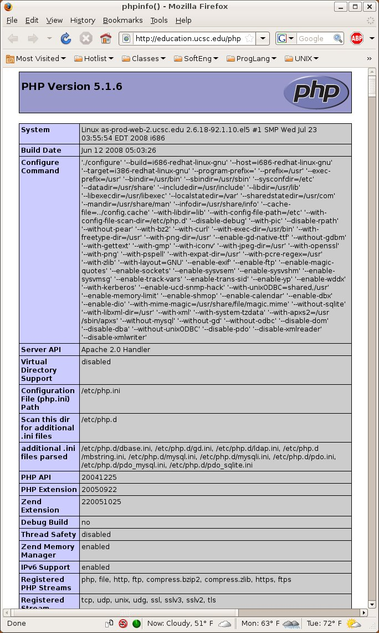
Default Content
Default content includes
Debug + test functions.
Sample scripts.
Manuals + images.
Example: phpinfo.php

Slide 54
Directory Listings
Web server may respond to dir request by
Returning default resource in directory, such as index.html.
Returning an error, such as 403 Forbidden.
Returning a listing of the directory.
Directory listings may lead to problems:
Leftover files, such as backups, logs, etc.
Attacker can identify resources that may not be properly protected by access control.

Slide 55
Web Server as Proxy
Web servers sometimes configured as proxies to send requests to other servers.
If may be possible to use a server proxy to
Attack third-party systems on the Internet.
Access internal systems that are protected by the firewall from direct external access.
Access other services on internal host that are protected by the firewall.

Slide 56
Testing for Proxies
Modify URL to access other hosts:
telnet example.com 80
GET http://other.example.com:80/ HTTP/1.0
Use the CONNECT method
telnet example.com 80
CONNECT other.example.com:80 HTTP/1.0
Can use to port scan
Try combinations of IP address + port.
If receive banner, then port is open on IP.

Slide 57
Web Services
Web services are designed to provide:
Interoperability: services can be built on any framework in any language.
Reuse: code can be re-used among different applications.
Services should be
Self-describing
Discoverable
Content-independent
Stateless

Slide 58
Web Service Technologies
HTTP
XML
XPath
SOAP
WSDL

Slide 59
eXtensible Markup Language
Extensible descriptive markup language framework
Primarily used for data communication and storage.
Tree-based document structure using <> tags.
Began as simplified subset of SGML.
<?xml version="1.0" encoding="UTF-8"?>
<inventory>
<book isbn=“0976694042”>
<author>Chris Pine</author>
<title>Learn to Program</title>
</book>
</inventory>

Slide 60
XML Tree Structure
<todo>
<title>
Monday’s List
</title>
<item>
Study for midterm
</item>
<item>
<priority=10/>
SSE Class
</item>
<item>
Bathe cat
</item>
</html>
todo
title
Tuesday’s List
item
Study for midterm
item
Scripting Class
priority
10
item
Bathe Cat

Slide 61
Elements and Attributes
An element consists of tags and contents
<title>Learn to Program</title>
Begin and end tags are mandatory.
<isbn number=“0976694042” />
Tags must be consistently nested.
Attributes
number=“0976694042”
Elements may have zero or more attributes.
Attribute values must always be quoted.

Slide 62
XML Entities
Entities are named data.
Default: &lt; &gt; &amp; &apos; &quot;
New entities can be defined in DTD.
Entities definitions can be recursive.
<?xml version="1.0" encoding="UTF-8"?>
<!DOCTYPE example [
<!ENTITY copy "&#xA9;">
<!ENTITY copyright-notice "Copyright &copy; 2009, XYZ Enterprises">
]>
<example> &copyright-notice; </example>
Numeric character references are not entities.
&#<dec>; or &#x<hex>; refers to Unicode code point.
&#xA9 above is used to refer to the copyright symbol.
Notes:
Example from http://en.wikipedia.org/wiki/XML

Slide 63
XML Syntax Rules
There is one and only one root tag.
Begin tags must be matched by end tags.
XML tags must be properly nested.
XML tags are case sensitive.
All attribute values must be quoted.
Whitespace within tags is part of text.
Newlines are always stored as LF.
HTML-style comments: <!-- comment -->

Slide 64
Correctness
Well-formed
Conforms to XML syntax rules.
A conforming parser will not parse documents that are not well-formed.
Valid
Conforms to XML semantics rules given in
Document Type Definition (DTD)
XML Schema
A validating parser will not parse invalid documents.

Slide 65
Malicious XML
Insert additional <price> element.
XML is well formed.
Validity depends on DTD.
Application will accept if it doesn’t validate.
<bookOrder>
<title>XML Security</title>
<price>59.99</price>
<shippingAddress> <price>0.01</price>
<street>Nunn Drive</street>
<city>Highland Heights</city>
<state>KY</state>
</shippingAddress>
</bookOrder>

Slide 66
Validation
Ensure that elements are present and are leaf nodes.
DTD
<?xml version=“1.0” encoding=“UTF-8”?>
<!ELEMENT bookOrder (title, price, shippingAddress) >
<!ELEMENT title (#PCDATA) >
<!ELEMENT price (#PCDATA) >
<!ELEMENT shippingAddress (#PCDATA) >
Schema
<?xml version=“1.0”?>
<xs:schema xmlns:xs=http://www.w3.org/2001/XMLSchema >
<xs:element name=“bookOrder”>
<xs:element name=“title” type=“xs:string” />
<xs:element name=“price” type=“xs:string” />
<xs:element name=“shippingAddress” type=“xs:string” />
</xs:element>
</xs:schema>

Slide 67
Strict Validation
Schemas can also validate data using regexps.
<?xml version=“1.0”?>
<xs:schema xmlns:xs=http://www.w3.org/2001/XMLSchema >
<xs:element name=“bookOrder”>
<xs:element name=“title”>
<xs:restriction base=“xs:string”>
<xs:pattern value=“[A-Za-z0-9 ‘\-]*” />
</xs:restriction>
</xs:element>
<xs:element name=“price” type=“xs:decimal” />
<xs:element name=“shippingAddress”>
<xs:restriction base=“xs:string”>
<xs:pattern value=“[A-Za-z0-9 ,#\-\.\t\n]*” />
</xs:restriction>
</xs:element>
</xs:element>
</xs:schema>

Slide 68
Bypassing Validation
Include DTD in malicious XML file.
<?xml version=“1.0” encoding=“UTF-8”?>
<!DOCTYPE bookOrder [
<!ELEMENT bookOrder (title, price, shippingAddress) >
<!ELEMENT title (#PCDATA) >
<!ELEMENT price (#PCDATA) >
<!ELEMENT shippingAddress ANY >
]>
<bookOrder>
<title>XML Security</title>
<price>59.99</price>
<shippingAddress> <price>0.01</price>
<street>Nunn Drive</street>
<city>Highland Heights</city>
<state>KY</state>
</shippingAddress>
</bookOrder>
Alternately: <!DOCTYPE bookOrder SYSTEM “DTD_URL">

Slide 69
External Entity References
Use entity references to read files on server filesystem.
<?xml version=“1.0” encoding=“UTF-8”?>
<!DOCTYPE bookOrder [
<!ELEMENT bookOrder ANY >
<!ELEMENT title ANY >
<!ENTITY eer SYSTEM “c:\boot.ini”>
]>
<bookOrder>
<title>&eer;</title>
</bookOrder>

Slide 70
XML Injection
Include <price> element in shipping address.
User input for street is “Nunn Drive</street><price>0.01</price> <street>Nunn Drive”
<bookOrder>
<title>XML Security</title>
<price>59.99</price>
<shippingAddress>
<street>Nunn Drive</street><price>0.01</price><street>Nunn Drive</street>
<city>Highland Heights</city>
<state>KY</state>
</shippingAddress>
</bookOrder>

Slide 71
XPath
Language for selecting nodes from XML.
Combines directory-type paths + regexps.
XPath 2.0 basis for XQuery SQL-like language.
Examples
bo: children of bo node
/bo: root bo element
//bo: all bo elements
bo//title: all titles
//bo/[price=’39’]: all bo nodes with a price of 39.
<bo>
<title>XML Security</title>
<price>59.99</price>
<shippingAddress>
<street>Nunn Drive</street>
<city>Highland Heights</city>
<state>KY</state>
</shippingAddress>
</bo>

Slide 72
XPath Searching
<users>
<user id=“1234” name=“John” pass=“letmein”>
<user id=“2456” name=“Archi” pass=“password1”>
<user id=“3322” name=“Eddie” pass=“Eddie”>
<user id=“4321” name=“Lori” pass=“drowssap”>
</users>
XPathFactory xfac = XPathFactory.newInstance();
XPath xp = xfac.newXPath();
InputSource input = new InputSource(xmlFile);
String query = “//users/user[@name=‘” + name +
“’ and @pass=‘” + pass + “’”;
return xp.evaluate(query, input);
Notes:
Example from Secure Programming with Static Analysis

Slide 73
XPath Injection
Set pass to ‘ or ‘a’ = ‘a
//users/user[name=‘John’ and pass=‘’ or ‘a’ = ‘a’]
Returns all users.
Set name to ‘ or id=1 or ‘’=‘
//users/user[name=‘John’ or id=1 or ‘’=‘’ and pass=‘letmein’]
Returns all users with id=1
XQuery Injection in the future
Supports conditionals + loops.
User-defined functions.

Slide 74
Mitigating XPath Injection
Use XPath bind variables
Similar to SQL prepared statement variables.
XPathFactory xfac = XPathFactory.newInstance();
XPath xp = xfac.newXPath();
InputSource input = new InputSource(xmlFile);
XPathBindVariables bv = new XPathBindVariables();
xp.setXPathVariableResolver(bv);
bv.bindVar(“ID”, id);
bv.bindVar(“NAME”, name);
String query = “//users/user[@name=$NAME and @pass=$PASS”]”;
return xp.evaluate(query, input);
Notes:
Example from Secure Programming with Static Analysis

Slide 75
SOAP
Simple Object Access Protocol
RPC protocol using XML methods.
Primarily uses HTTP as transport protocol, to bypass firewalls and support proxies.
Vulnerabilities
XML injection
Session management
Identified + documented by WSDL

Slide 76
SOAP Request
POST /order HTTP/1.1
Host: example.com
Content-Type: text/xml; charset="utf-8"
Content-Length: nnnn
<soap:Envelope xmlns:soap ="http://schemas.xmlsoap.org/soap/envelope/"
soap:encodingStyle="http://schemas.xmlsoap.org/soap/encoding/">
<soap:Body xmlns:m=“http://example.com/order">
<m:OrderBook>
<m:isbn>978-0321424778</m:isbn>
<m:quantity>1</m:quantity>
</m:OrderBook>
</soap:Body>
</soap:Envelope>

Slide 77
SOAP Response
HTTP/1.1 200 OK
Content-Type: text/xml; charset="utf-8"
Content-Length: nnnn
<soap:Envelope xmlns:soap ="http://schemas.xmlsoap.org/soap/envelope/"
soap:encodingStyle="http://schemas.xmlsoap.org/soap/encoding/">
<soap:Body xmlns:m=“http://example.com/order">
<m:OrderBookResponse>
<m:isbn>978-0321424778</m:isbn>
<m:price>49.99</m:price>
<m:quantity>1</m:quantity>
</m:OrderBookResponse>
</soap:Body>
</soap:Envelope>

Slide 78
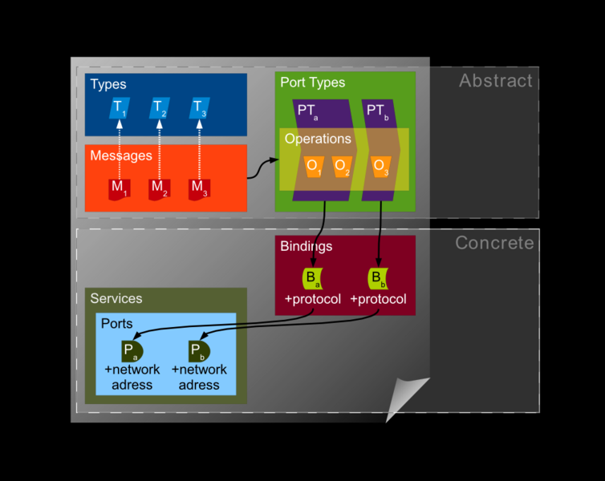
WSDL
Web Services Description Language
Service: contains set of messages.
Message: an individual operation.
Port: address (URL) of service.
Binding: port type, such as SOAP and SOAP binding type.
Notes:
Image from http://en.wikipedia.org/wiki/File:Wsdl.png

Slide 79
WSDL Enumeration
Obtain list of services and messages.
WSDL file typically published by default.
Finding WSDL files
Append ?WSDL or .WSDL to service URL.
Lookup WSDL files on UDDI servers.
Google hacking, filetype:wsdl inurl:wsdl
Mitigation
Avoid publishing WSDL file.
J2EE: remove wsdl.location from properties.

Slide 80
References
Nischal Bhalla and Sahba Kazerooni, “Web Services Vulnerabilities,” Black Hat Briefings EU, http://www.blackhat.com/presentations/bh-europe-07/Bhalla-Kazerooni/Whitepaper/bh-eu-07-bhalla-WP.pdf, 2007.
Brian Chess and Jacob West, Secure Programming with Static Analysis, Addison-Wesley, 2007.
Billy Hoffman and Bryan Sullivan, AJAX Security, Addison-Wesley, 2008.
Paco Hope and Ben Walther, Web Security Testing Cookbook, O’Reilly, 2009.
iSEC Partners, Attacking Web Services, OWASP AppSec DC, https://www.isecpartners.com/documents/iSEC-Attacking-Web-Services.OWASP.pdf, 2005.
Ramarao Kanneganti and Prasad Chodavrapu, SOA Security, Manning, 2008.
OWASP, OWASP Top 10 2010 Presentation, https://code.google.com/p/owasptop10/, 2010.
Dafydd Stuttart and Marcus Pinto, The Web Application Hacker’s Handbook, Wiley, 2008.
Sanctum, “HTTP Response Splitting Whitepaper,” http://www.packetstormsecurity.org/papers/general/whitepaper_httpresponse.pdf, 2004.
w3schools, SOAP Tutorial, http://www.w3schools.com/soap/default.asp.

